Slide 1
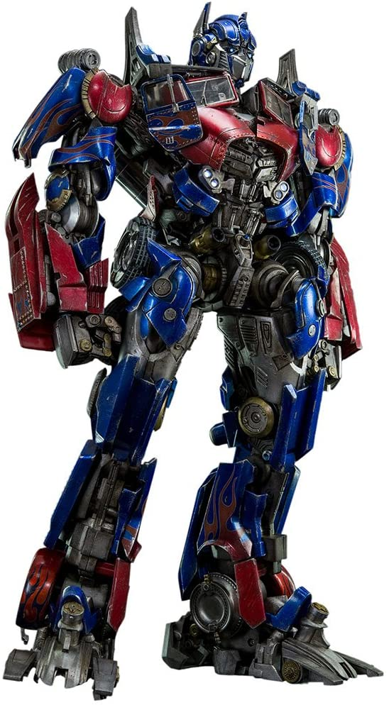
Image Classification using Vision Transformer
Sony Annem

Slide 2

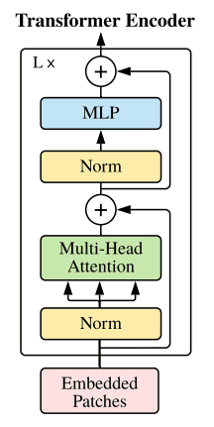
What is Vision Transfomer ?( Attention Is All You Need ! )

Slide 3
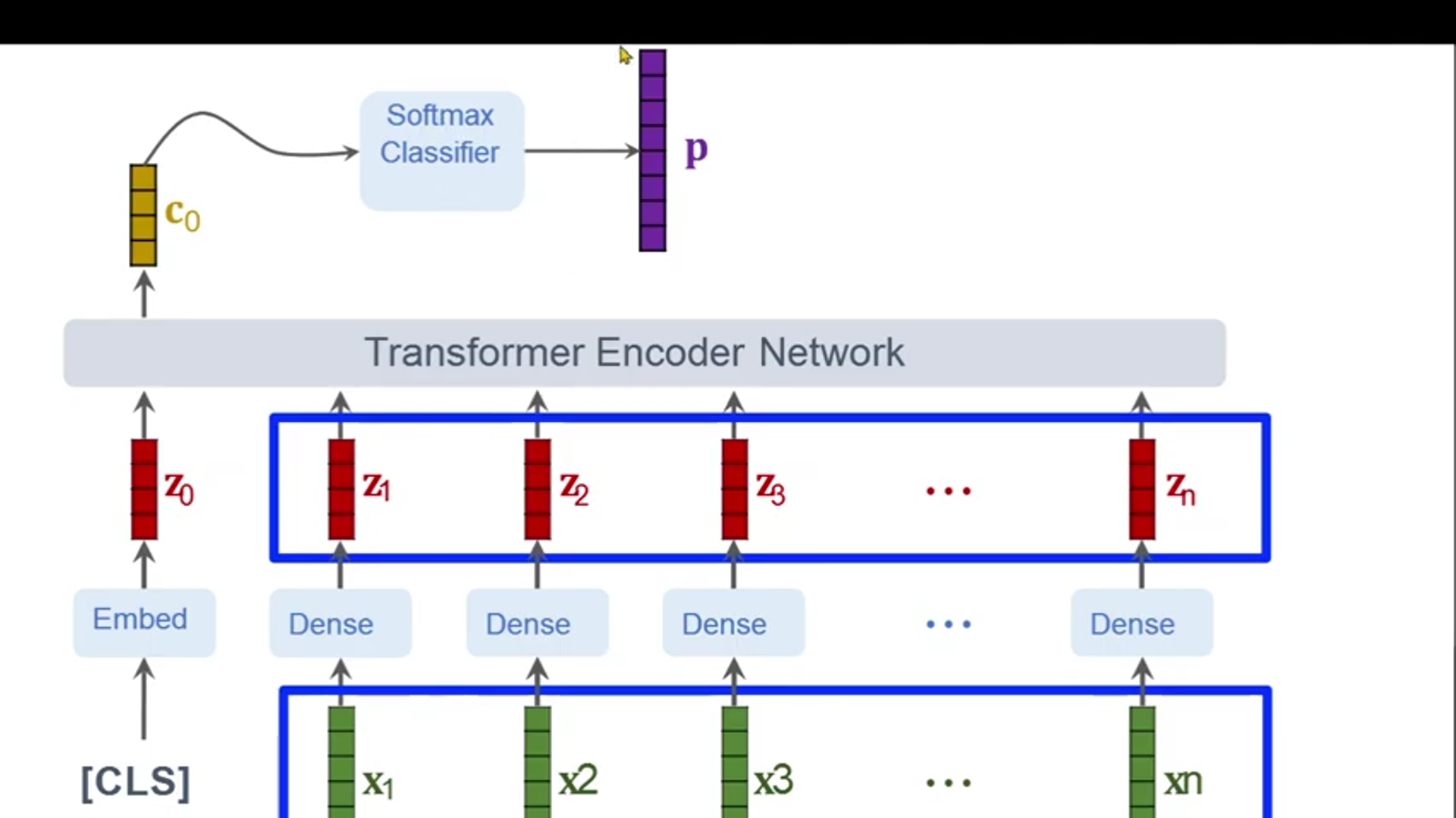


Working of ViT
Position Embedding

Slide 4

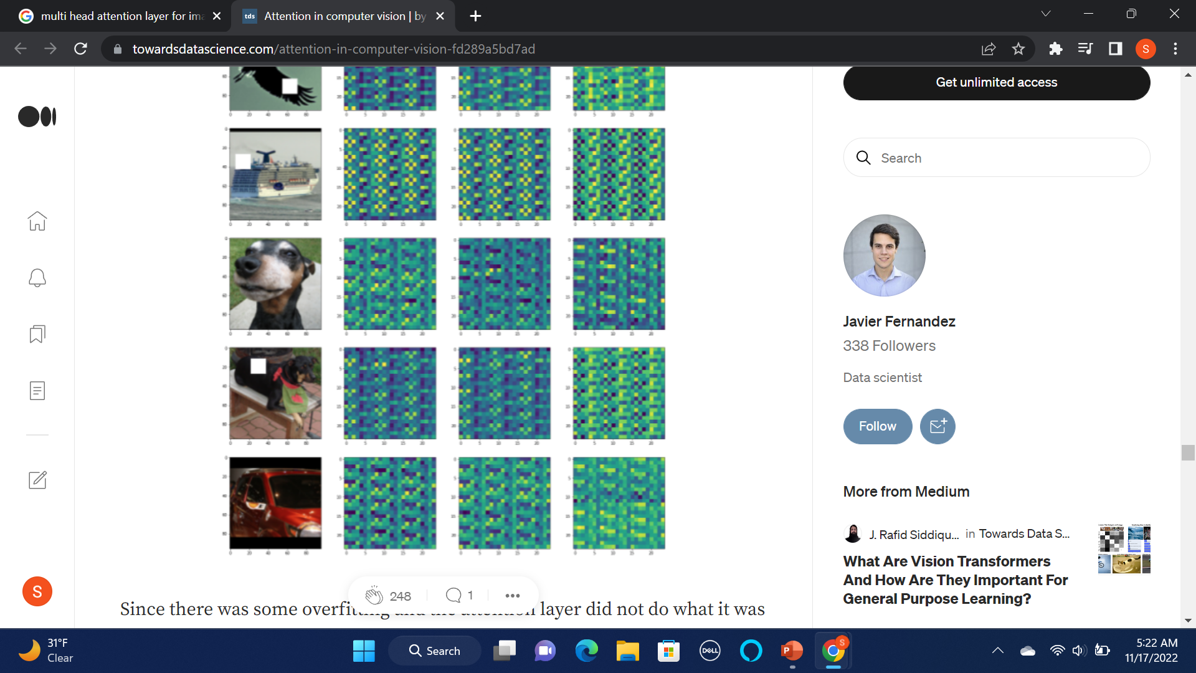


Practical knowledge

Slide 5

Modifications to given code
1. Change in Dataset:
Collected from https://www.kaggle.com/datasets/chazzer/smiling-or-not-face-data, from CIFAR.
---- 2 binary classes. 600 smiling faces in the "smile" folder. 603 non smiling faces in the "non_smile" folder.

Slide 6
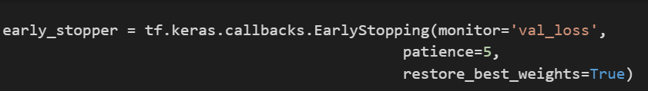
2. Added Early Stopping Mechanism
A significant challenge when training a model is deciding how many epochs to run. Too few epochs might not lead to model convergence, while too many epochs could lead to overfitting.
Early stopping is an optimization technique used to reduce overfitting without compromising on model accuracy. The main idea behind early stopping is to stop training before a model starts overfit.

Slide 7
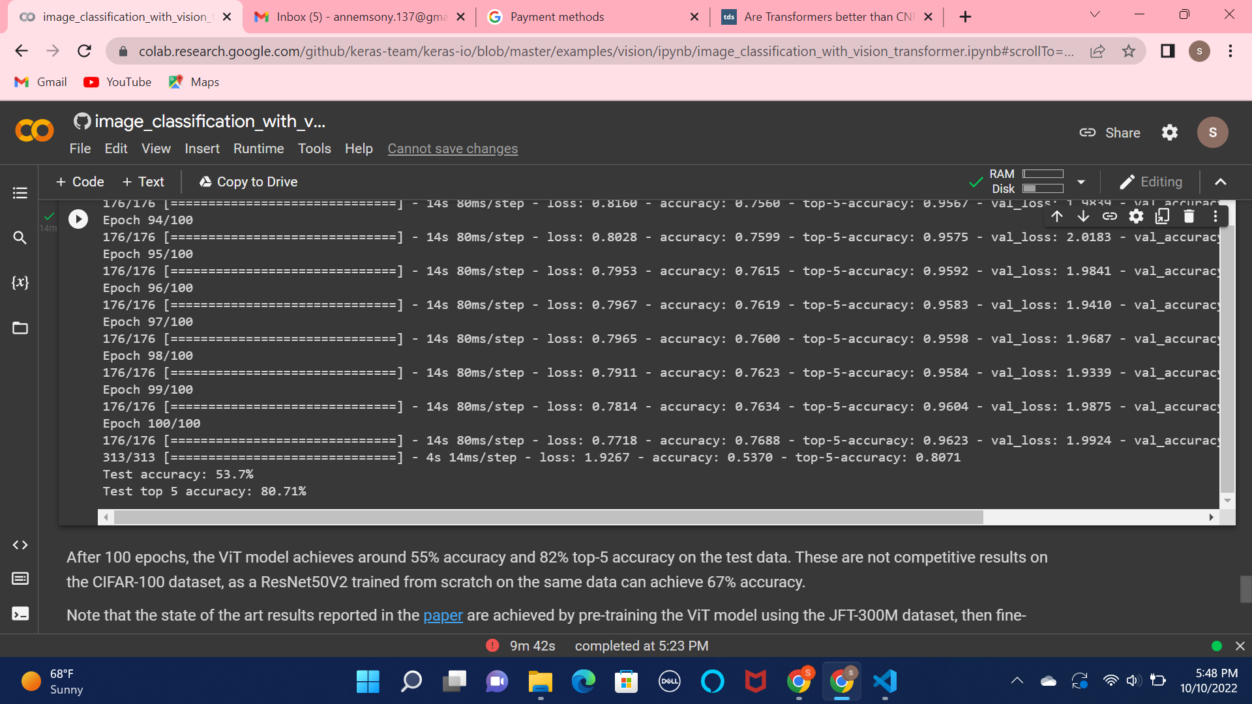
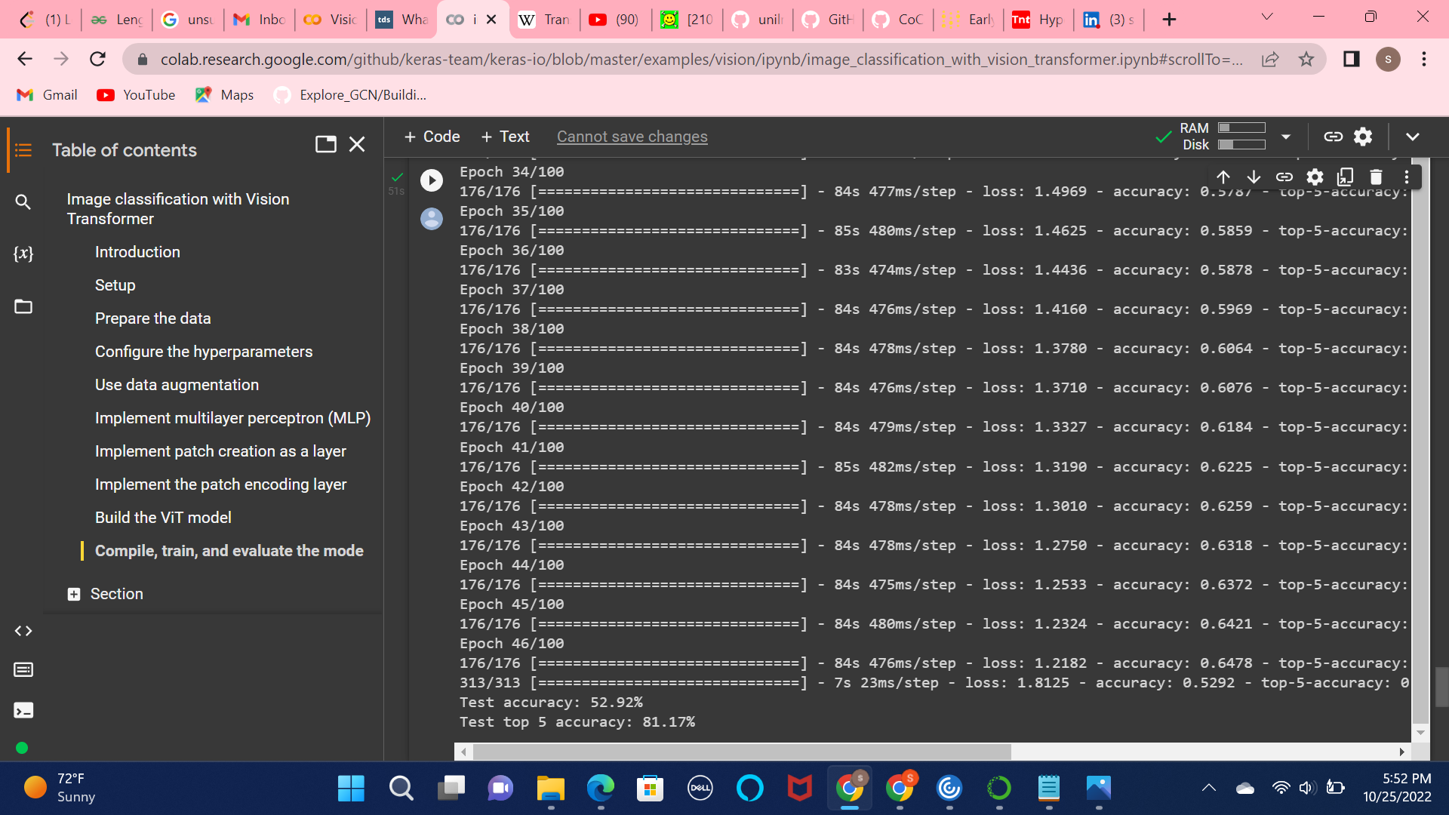
Results Without Early Stopping With Early Stopping

Slide 8
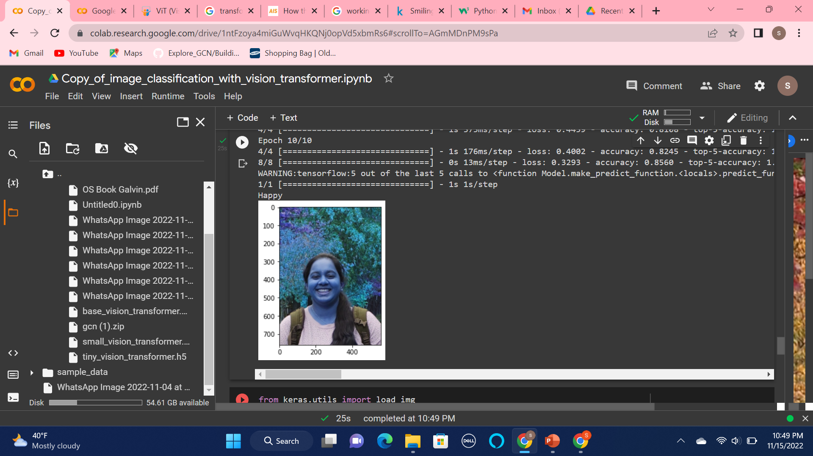
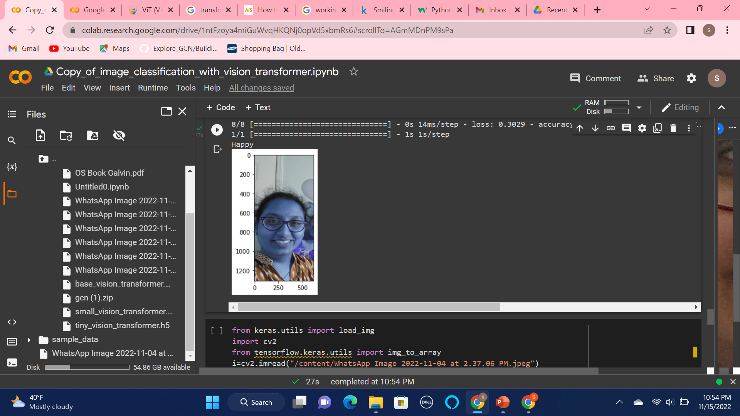
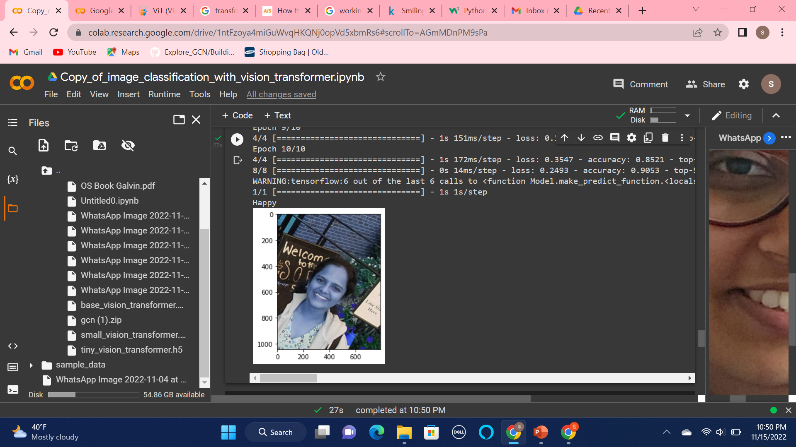
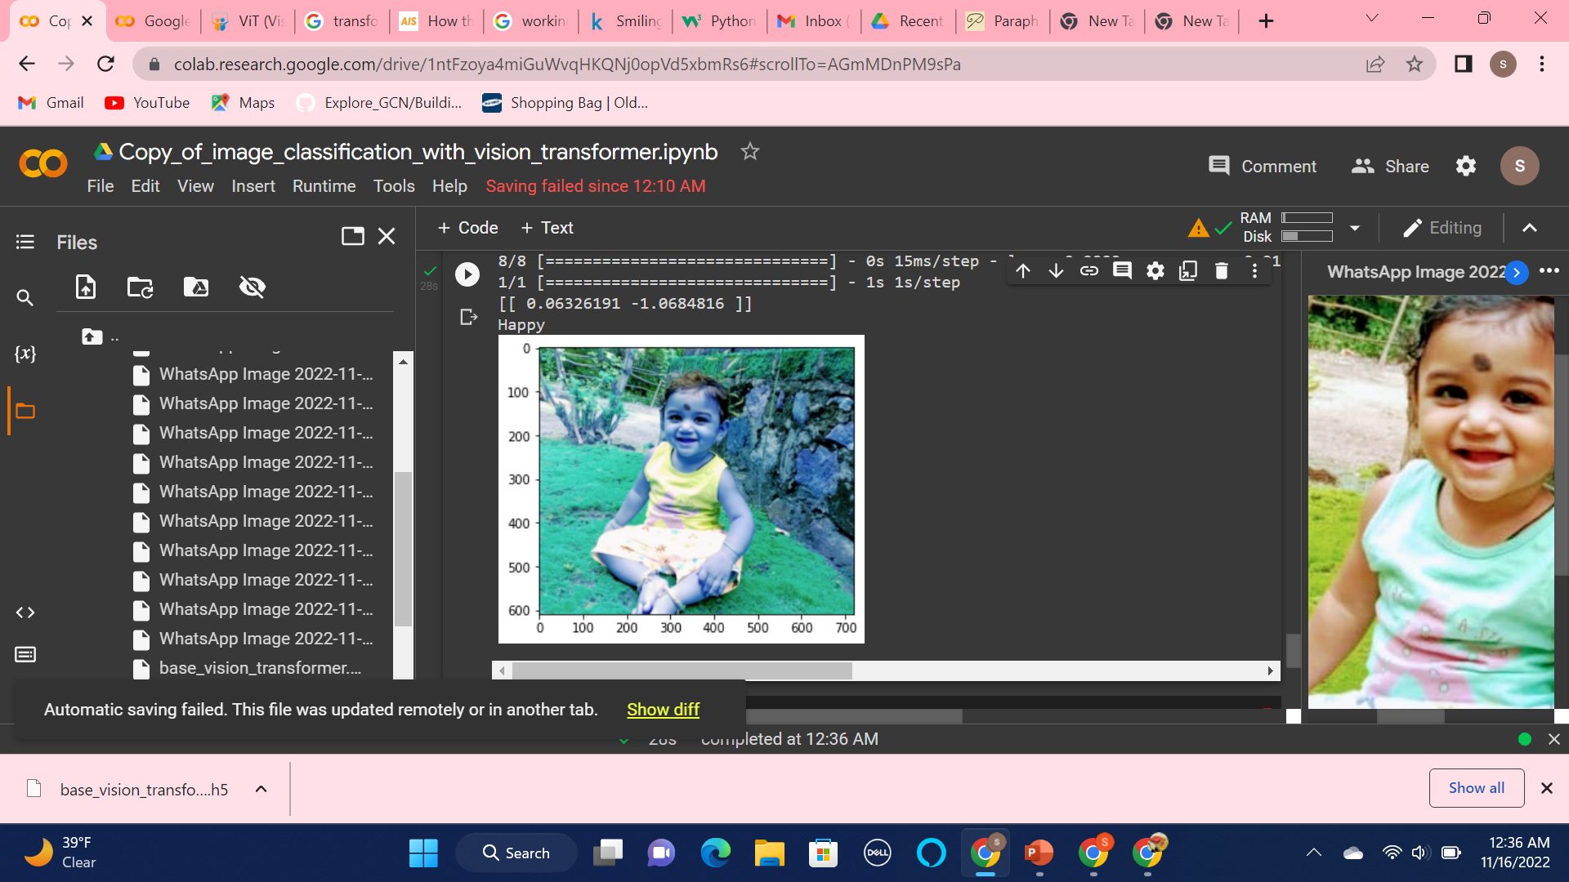
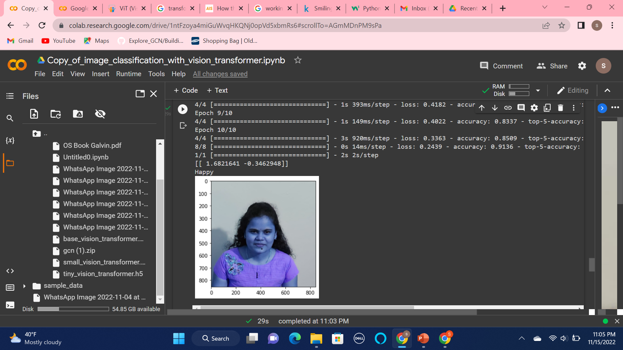
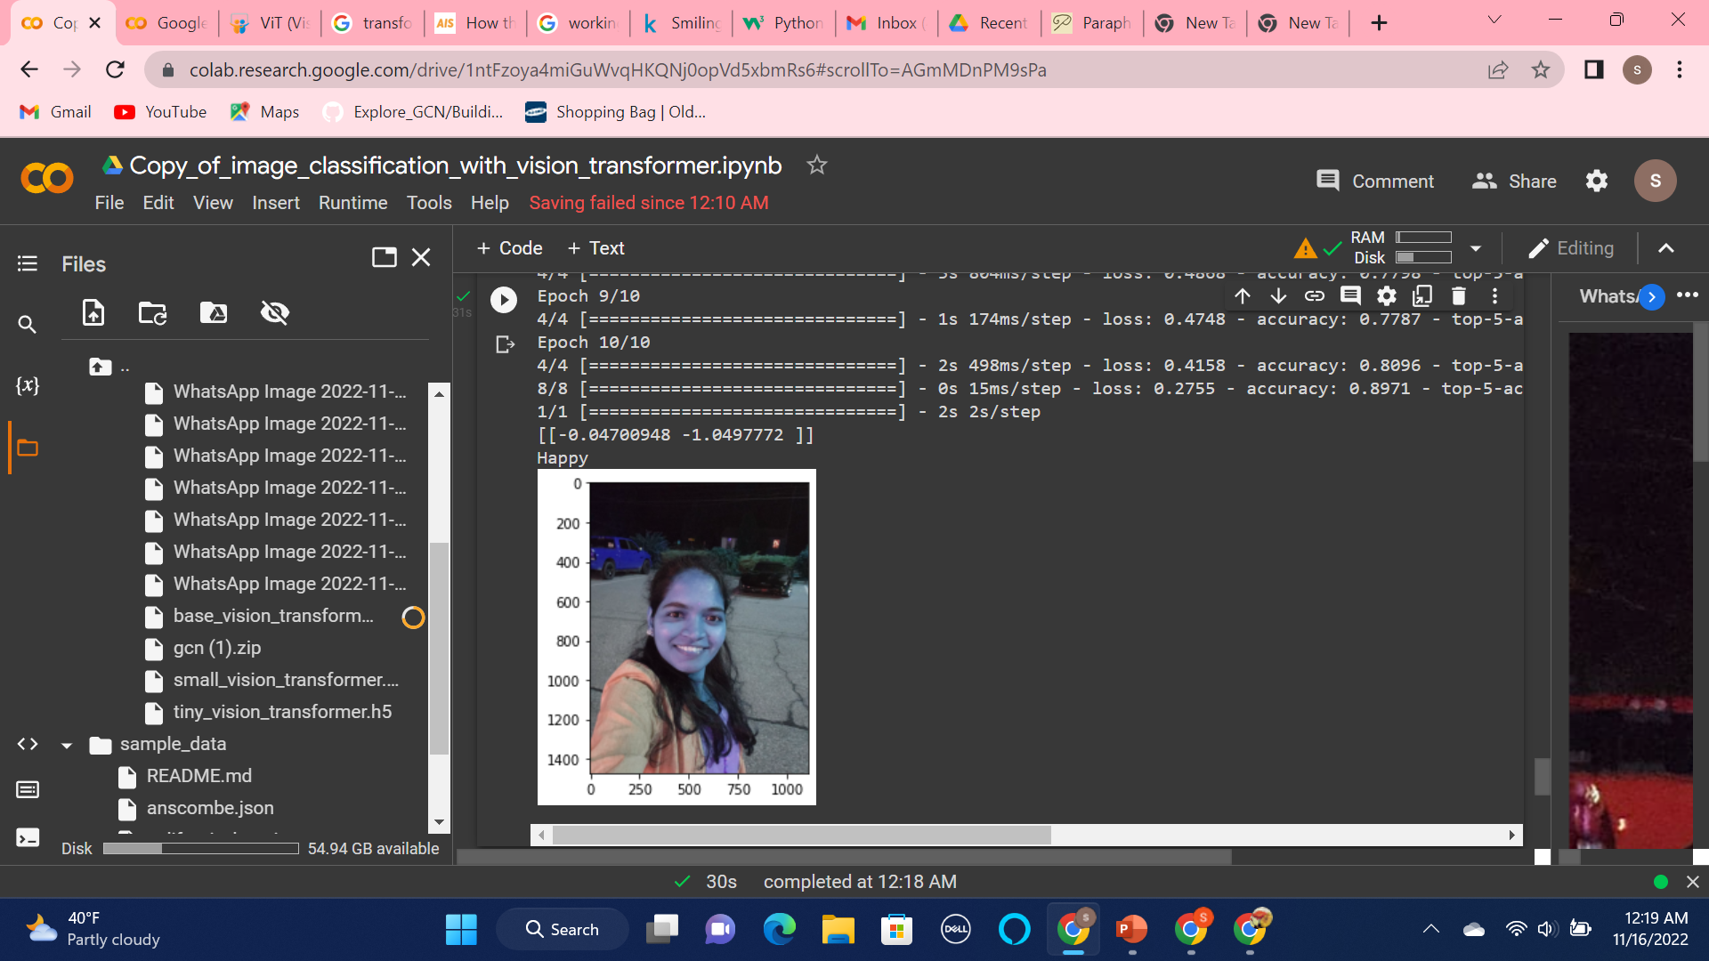
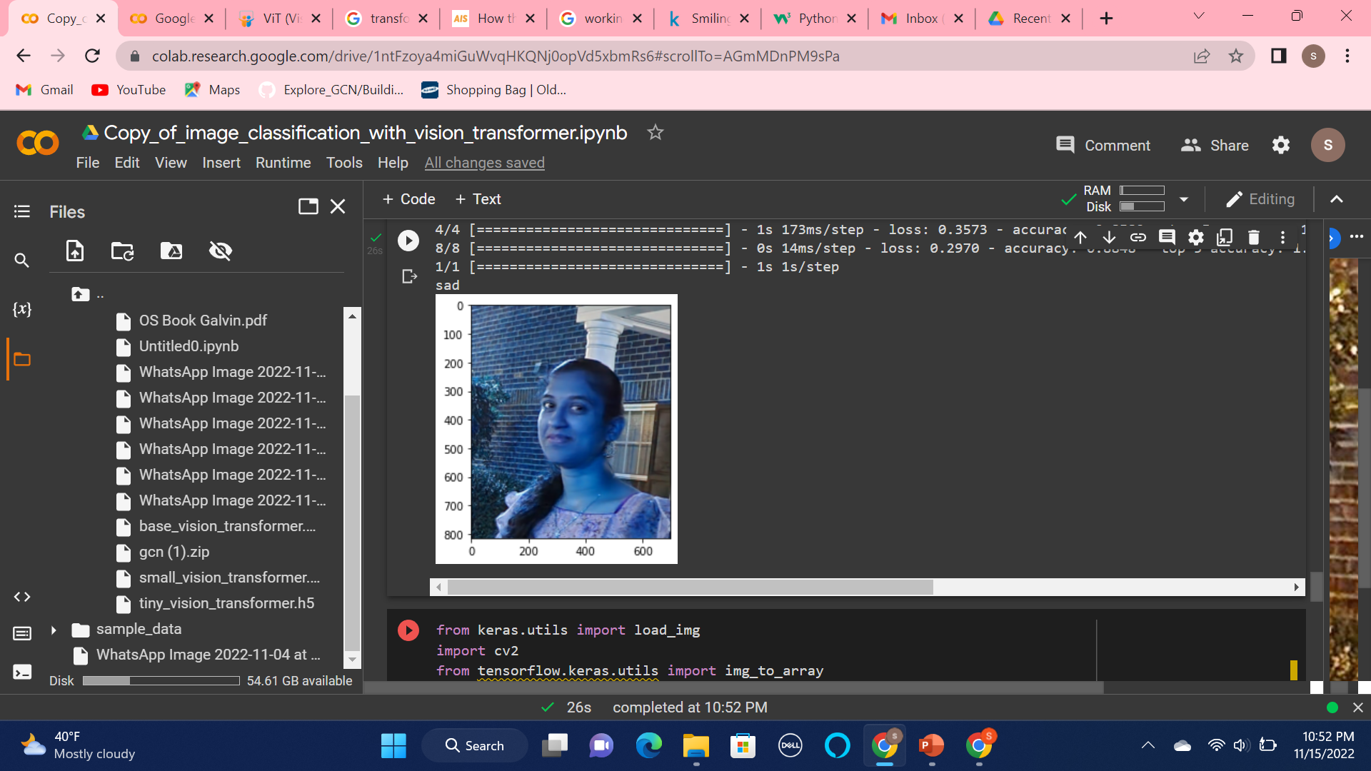
Testing the model:

Slide 9
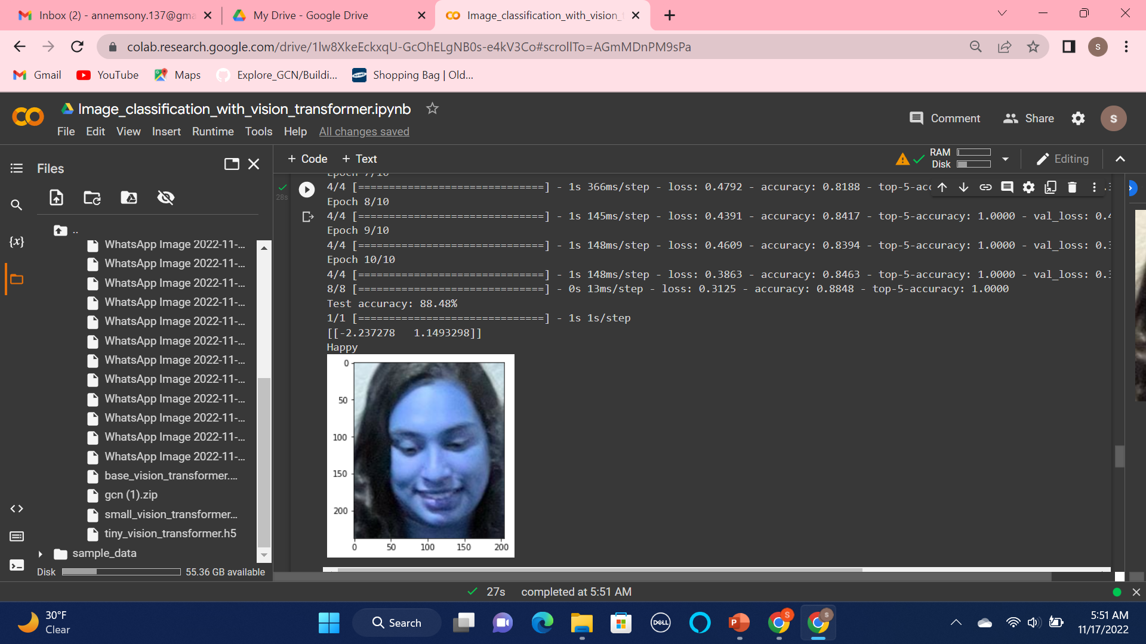
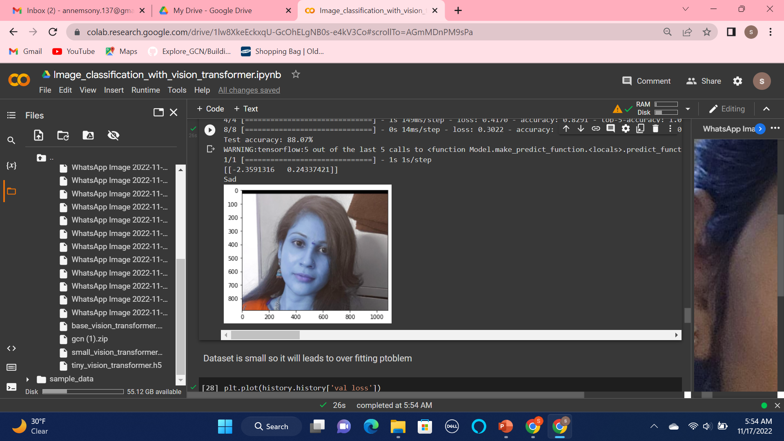
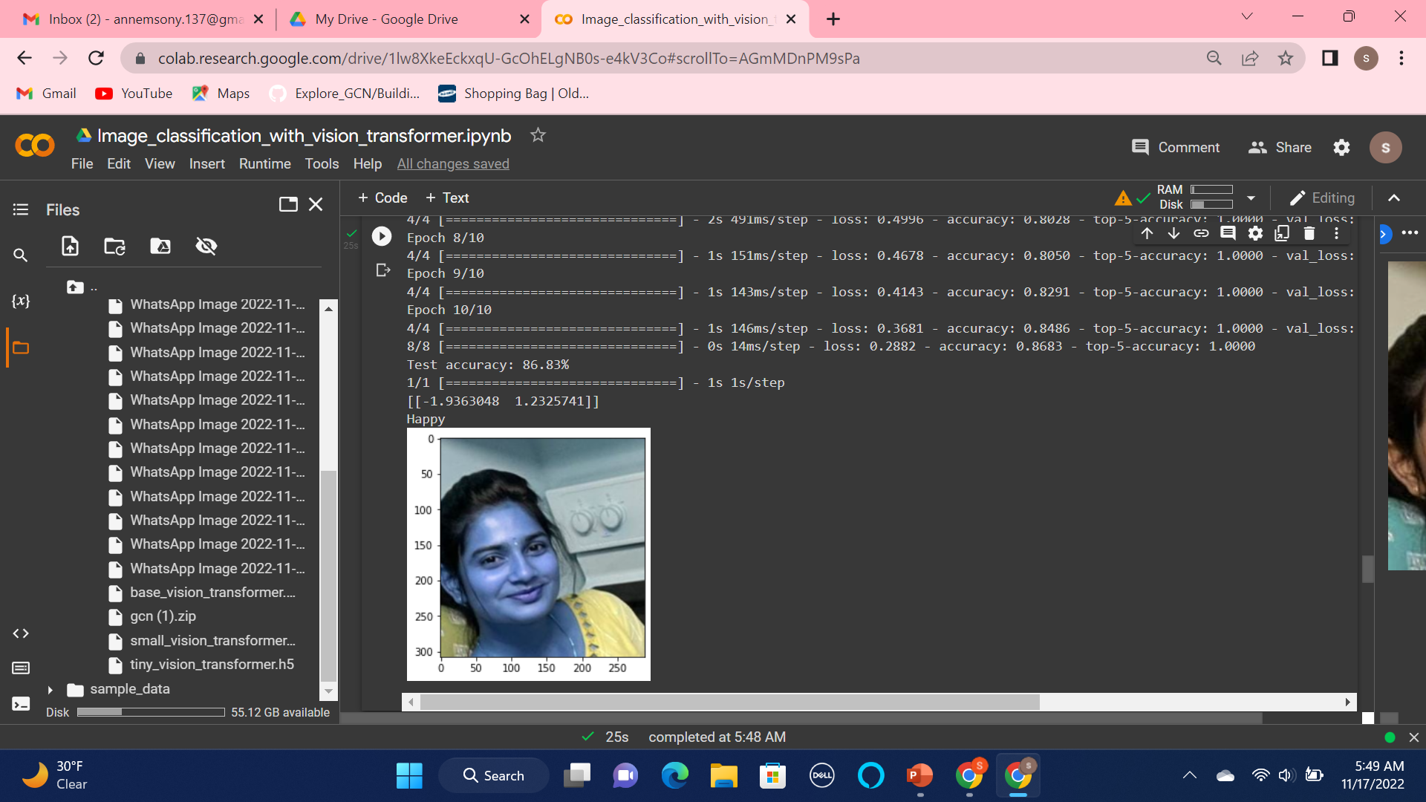
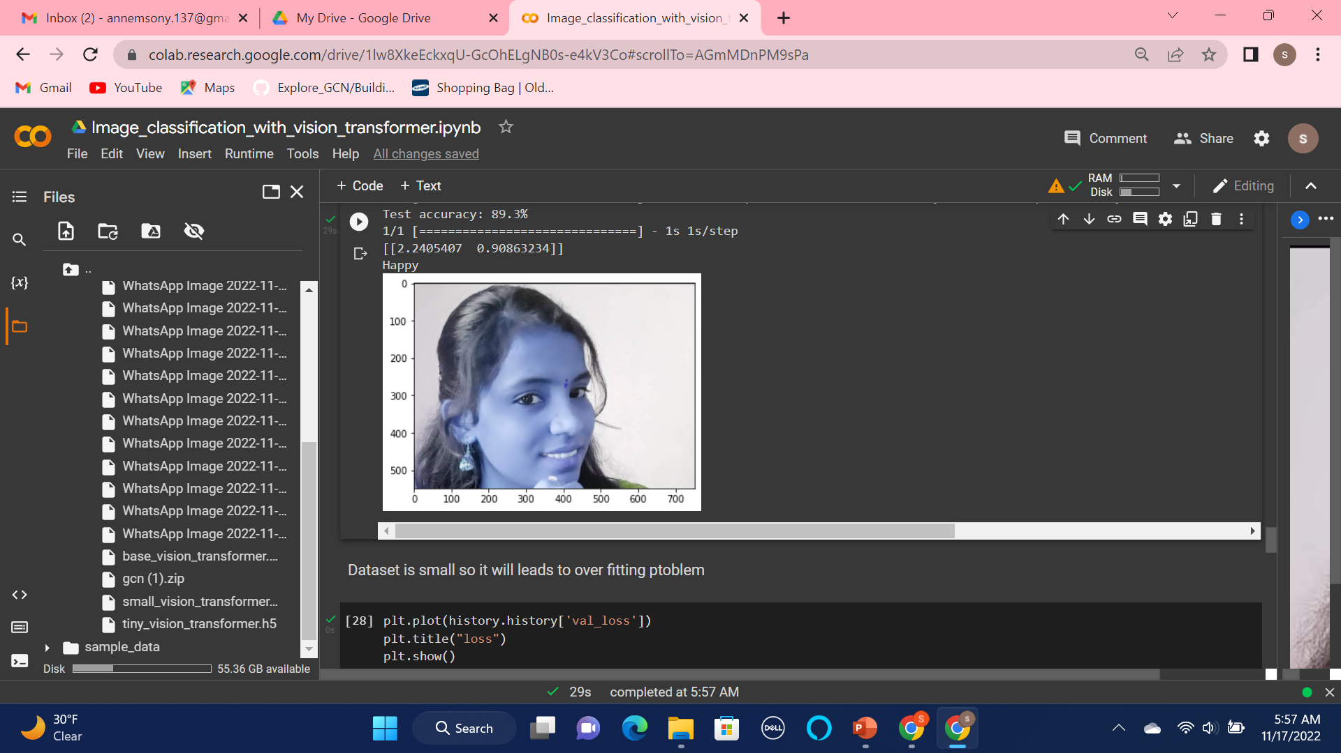
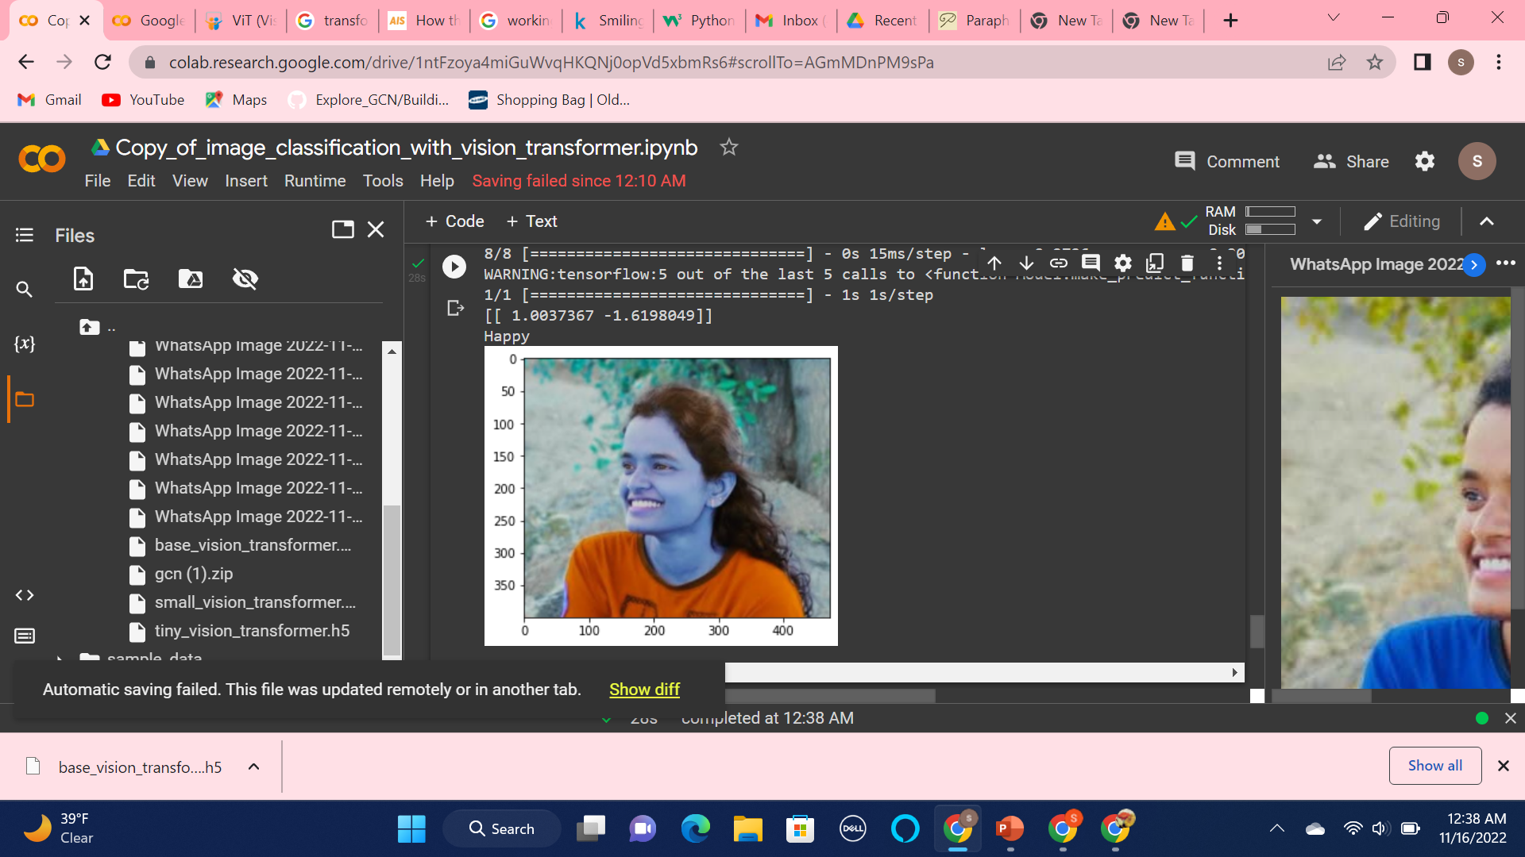

Slide 10
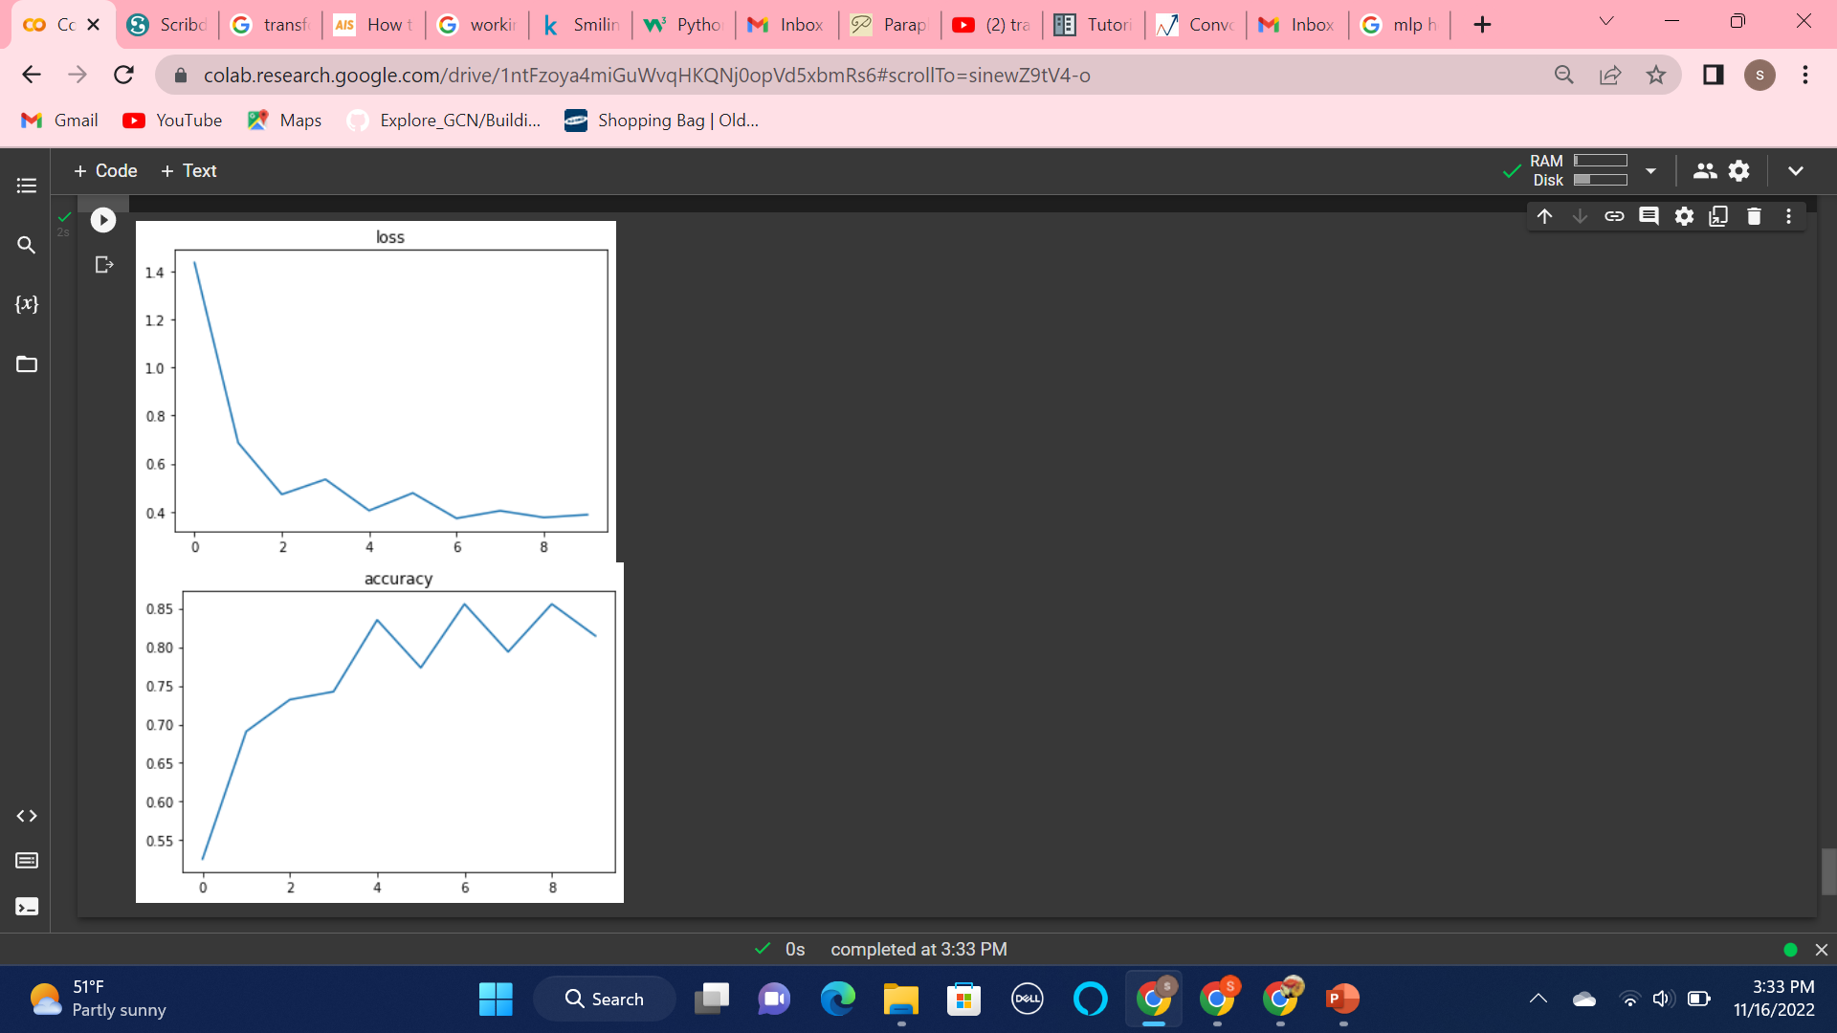
Results: Over all loss and accuracy for the model

Slide 11
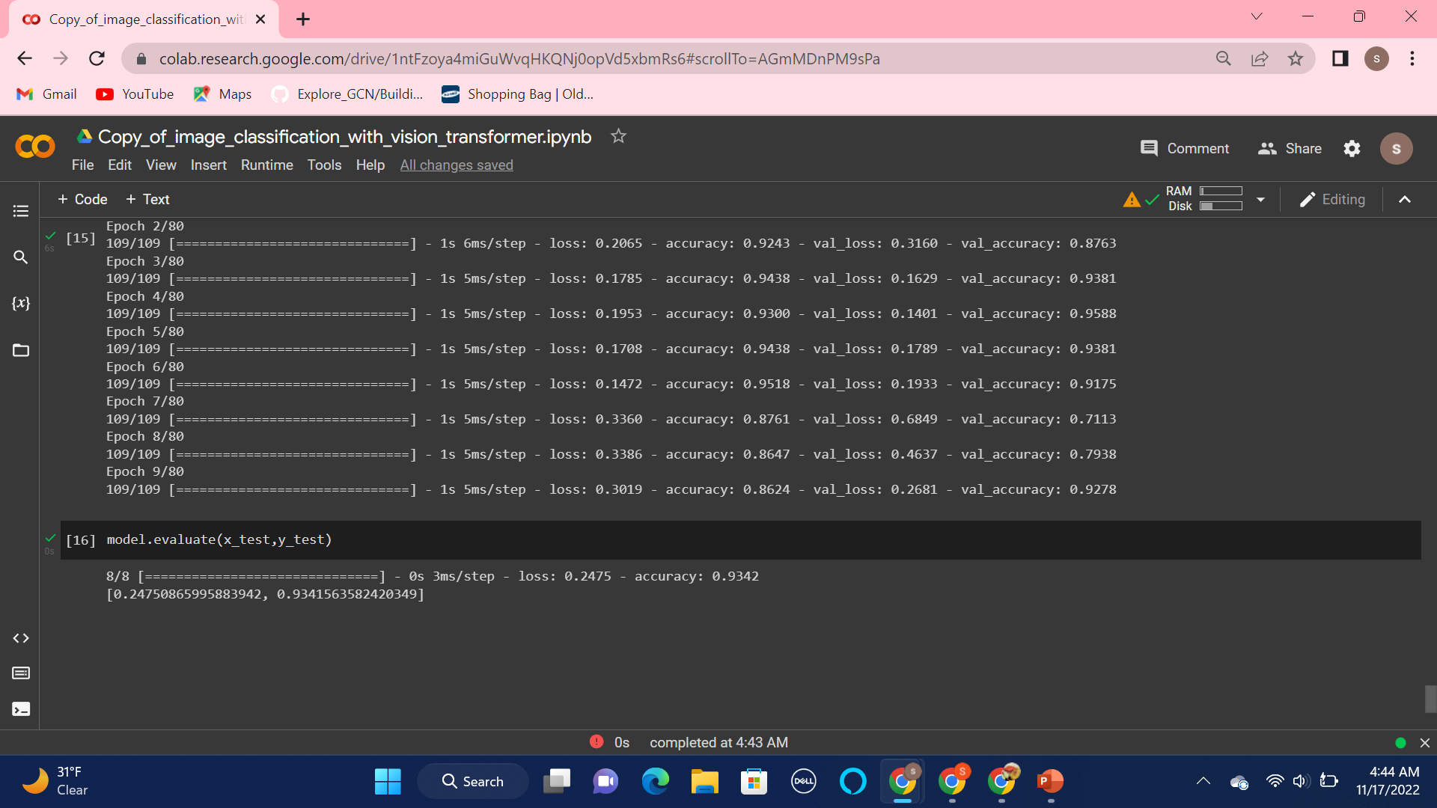
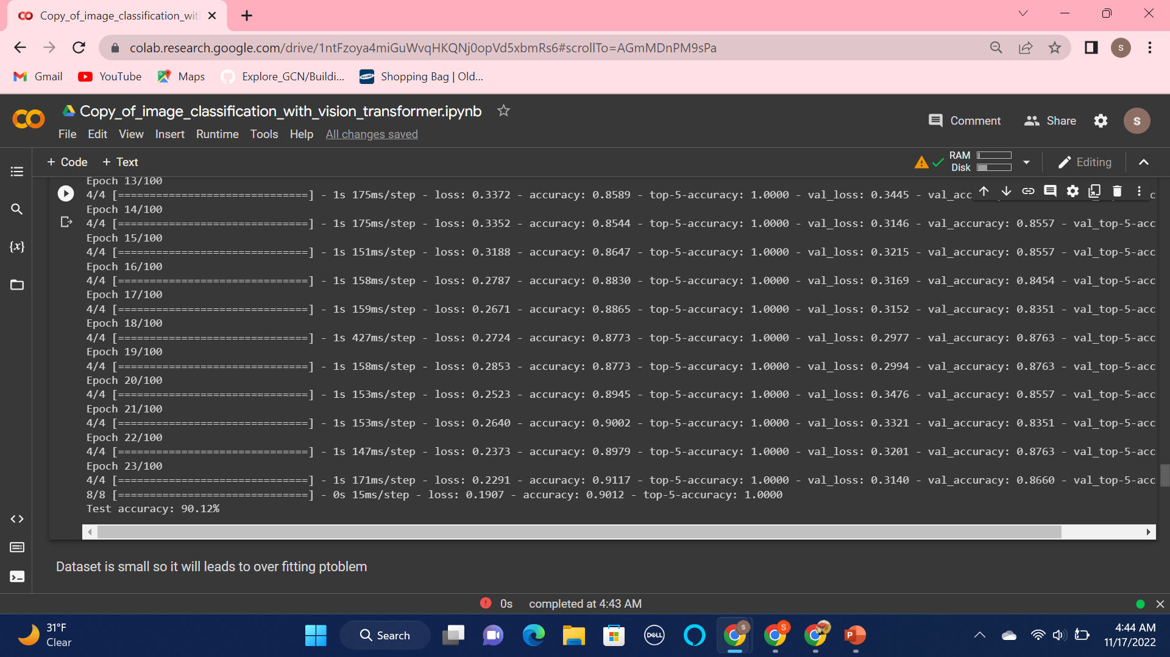
Comparison of CNN and Vit accuracy Epochs =100, patience=5 CNN achieves 93 %accuracy beats the vit for small dataset
T

Slide 12
Funnily there are more images in this world than novels.
Thank you

